Slide 1
Student Life

Slide 2
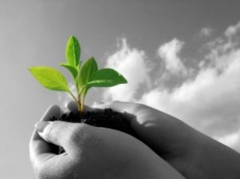
Vision for Area
Western Washington University strives to increase sustainability awareness and communication among the student body, as well as empower clubs and activist groups to increase collaboration and transparency with administration.

Slide 3
Goal: 1
Strive to build relevancy between student life and sustainable programs, while helping to build a cohesive community that shares the common goal of living a sustainability oriented life

Slide 4
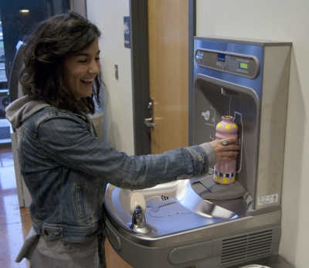
Objective 1.1
Objective 1.1: Increase resources and university support for programs that reinforce student awareness and set standards for sustainable student life at Western.
KPI (Key Performance Indicator): Measure energy consumption/recycling rates

Slide 5
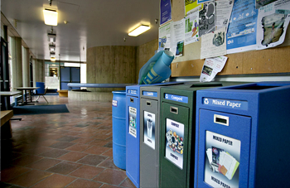
Objective 1.2
Objective 1.2: Increase awareness of Western’s sustainable norms and practices among the student body.
KPI: Literacy Test/Student Survey

Slide 6
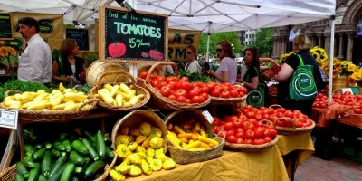
Objective 1.3
Objective 1.3: Bolster sense of community and responsible citizenship through sustainability and a recognition of a greater connection to Whatcom County and the planet.

Slide 7
Goal:2
Raise the level of organization and collaboration between student clubs and administrative bodies such as the AS, and prioritize sustainability clubs in terms of resource availability and support.

Slide 8
Objective 2.1
Objective 2.1:Increase transparency, efficiency, and collaboration between WWU administrators, the AS, and students.
KPI: Measure Clubs’ opinions via survey

Slide 9
Special Thanks To: Nina Olivier, John Purdie, Jacob DeGuzman, Kendra Krantz, Maddie Gavigan, Kevin Majcut and Seth Vidana

