Slide 1
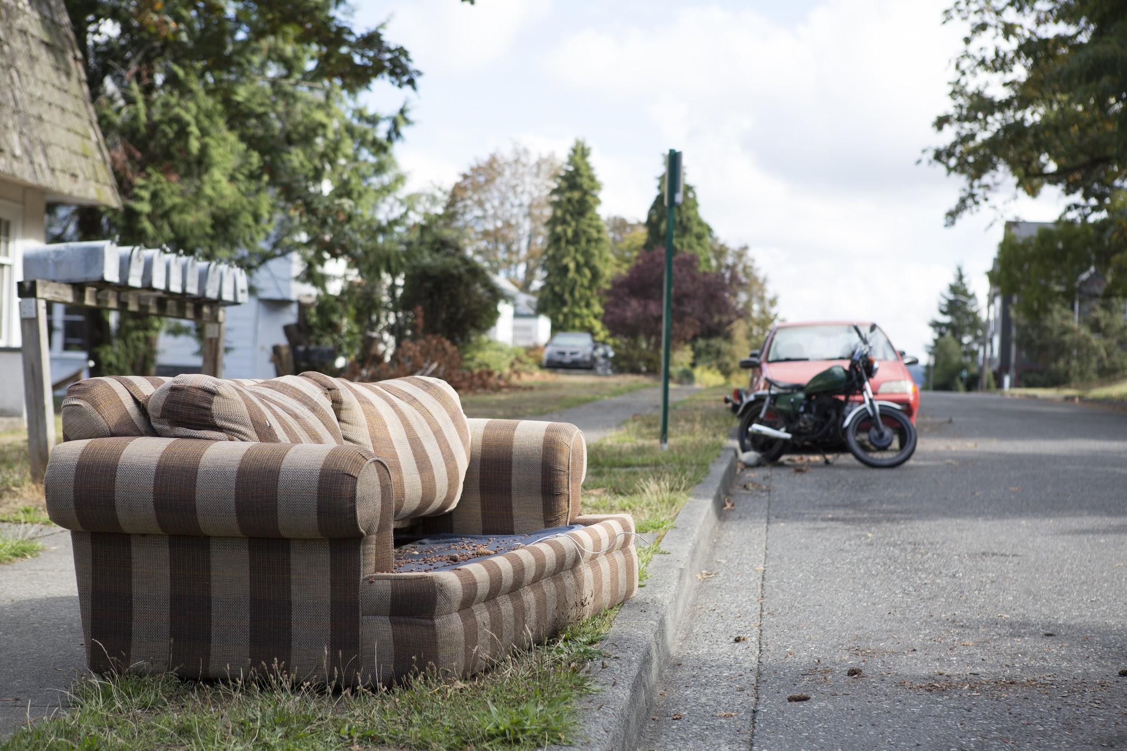
asfsDGSDGsgSDG
STREET WASTE CLEANUP
Akemi Fujii
&
Josh Ludden

Slide 2
Issue & Statement Of Need
What is the Issue?
Too much trash on the streets
Statement of need
Causing frustration amongst the community members
Makes our city and school look bad
Mass amounts sent to landfill
Give items a second home

Slide 3
Case Studies
Have students donate any unwanted items
Working together with Waste Management Services
They will pick up, sort and donated to local Non-Profit

Slide 4
Case Studies
Promote student recycling of unwanted items
Uses Facebook for student accessible info
Provides information about local Goodwills
Have dumpster-like containers both on campus and off campus
Offer scheduled pick-up service for large items

Slide 5
Case Studies
Rummage Sale
Allow low income community goods at discounted prices
Profits to underprivileged children in Colombia
Worked with local company Tiger Pantry
Emails, 96 gallon carts, posters, yard signs, newspapers & TV Stations
Results:
Diverted 20 tons from landfill
Raised over $10,000 for the children

Slide 6
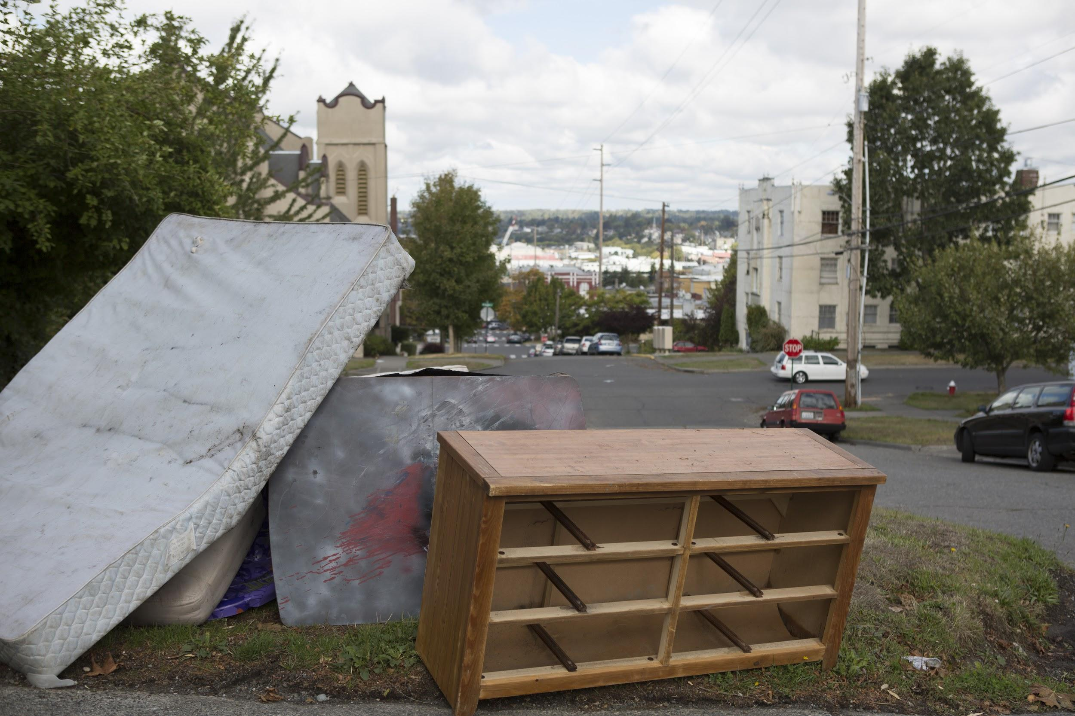
What We Know
So Far...

Slide 7
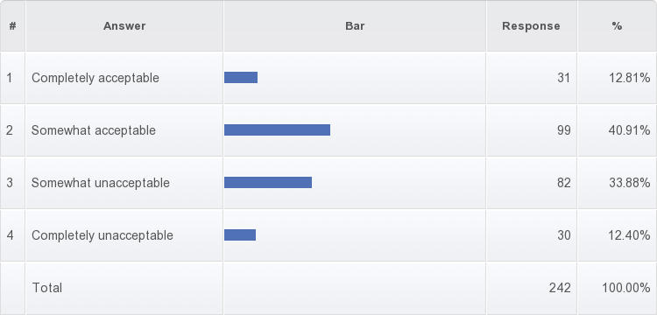
Survey Results

Slide 8
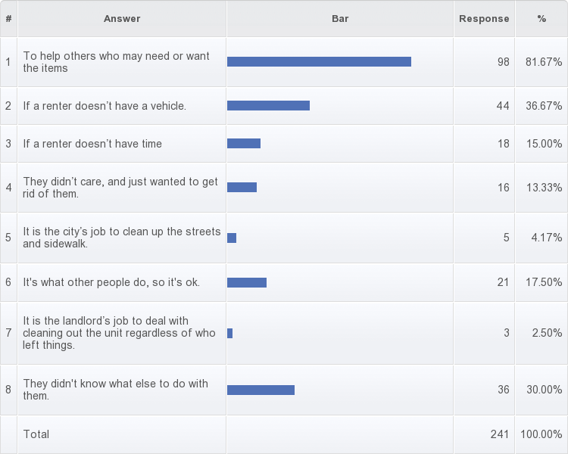

Slide 9
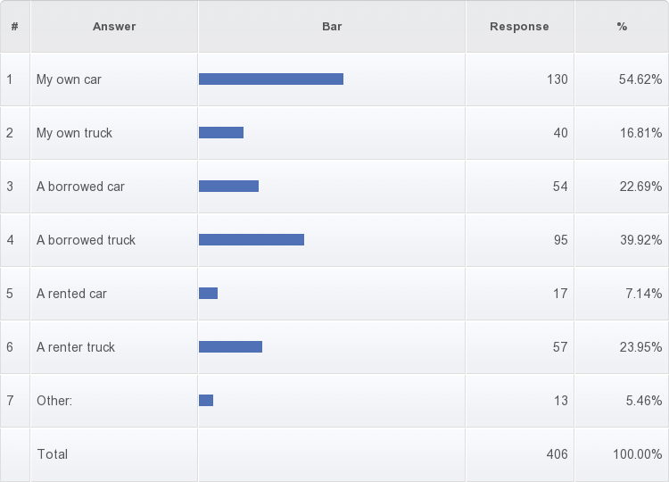

Slide 11
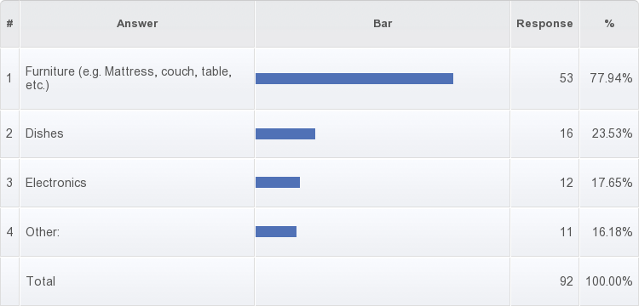

Slide 12
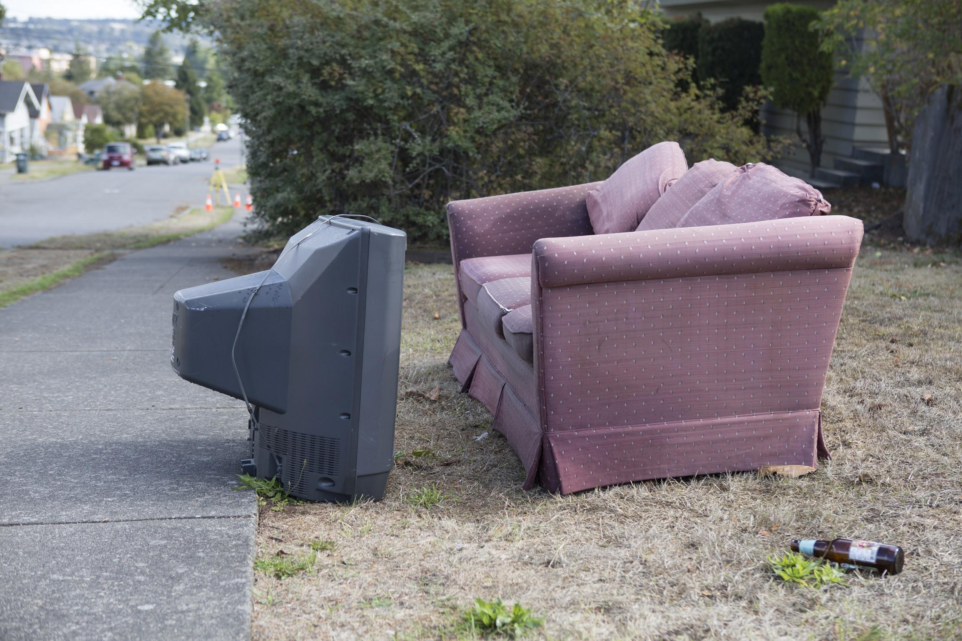
Possible
Solutions

Slide 13
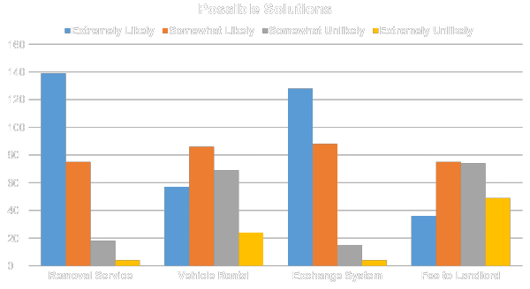

Slide 14
Stakeholders
Kate Nichols - Happy Valley Neighborhood Representative
Carla Stellwagen - Sehome Neighborhood Representative
Eric Osterkamp - Neighborhood Police Officer (BPD)
Anitra Accetturo- Water Conservationist
Dr. Gene Myers- Environmental Studies Professor
Carmen Rasmussen- Campus Community Coalition

Slide 15
Conclusion
The data gathered from the survey was very helpful and gave us a better understanding of student beliefs and behaviors
Points us towards the most desired programs to reduce this issue
Continue working beside the community to make sure there is no longer an issue

