Slide 1
Sustainability Action Plan
Transportation

Slide 2
Special Thanks
Carol Berry - Sustainable Transportation Program Manager
Reatha Cammack - Facilities Management Program Manager
Maxwell Evans - A.S. Student Transportation Coordinator
Julia Gassman - Manager of Parking Services and Transportation
Kay McMurren - Student Transportation Program Support Supervisor

Slide 3
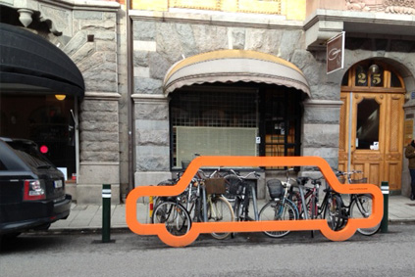
Vision
Western Washington University
will become a national leader in low- carbon transportation strategies by providing and fostering a diverse assortment of affordable and alternative transportation.

Slide 4
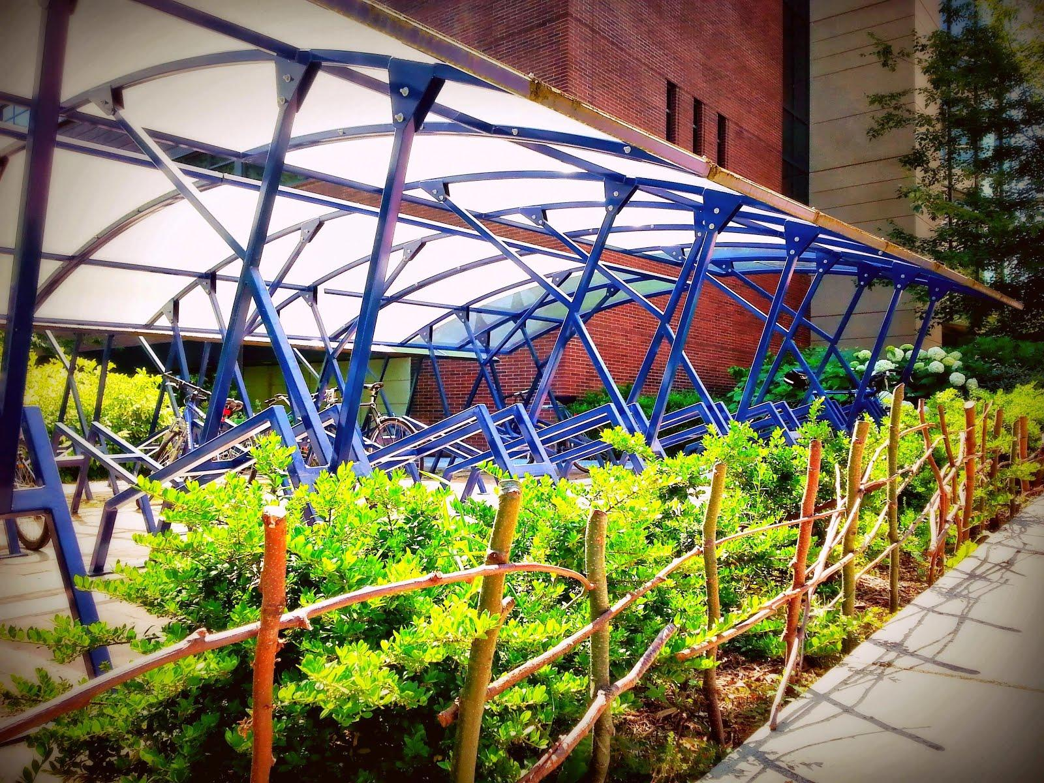
Range of Transportation
Campus fleet vehicles
Student-specific transportation
Commuting to campus
All alternatives (bicycling, walking, etc.)

Slide 5
Challenges & Opportunities
Most transportation changes require large investments
Country is heavily dependent on personal vehicles
Lots of enthusiasm for new technology
Sustainability is becoming socially expected for universities
Notes:
*personal transportation has come to mean I drive everywhere I want alone and that’s okay

Slide 6
Transportation Goals
1: Regularly conduct & update a mode-share survey
2: Reduce number of SOV trips
3: Reduce the amount of fuel purchased
4: Reduce environmental impacts of parking
5: Increase accommodation for cyclists
6: Manage the increase in ridership on WTA bus lines
Notes:
In order of importance

Slide 7
Key Performance Indicators
Volume of fuels purchased
Decrease 5% - 35% by 2025
Number of SOV trips to and from campus
Decrease 25% by 2018
Number of bicycles parked on campus
Increase 15% by 2018
Reduce parking lot gravel runoff
Meet or exceed requirements of Clean Water Act (TMDL) by 2016
Notes:
TMDL explain background - why and how bad - connelly creek---padden creek----Whatcom creek (salmon) and 303d polluted streams list

Slide 8
Abridged Action Plan
Achievability | Action Step
With Available Resources | Lower vehicle miles driven
 | Increase educational campaigns
With Additional Resources | Regularly conduct & update mode-share survey
 | Accommodate increase of cyclists
With Institutional Investment | Meet WA State Clean Water Act standards
 | Increase use of EVs
Policy Change | Restructure sustainable transportation funding
 | Create FM break & storage area on main campus

Slide 9
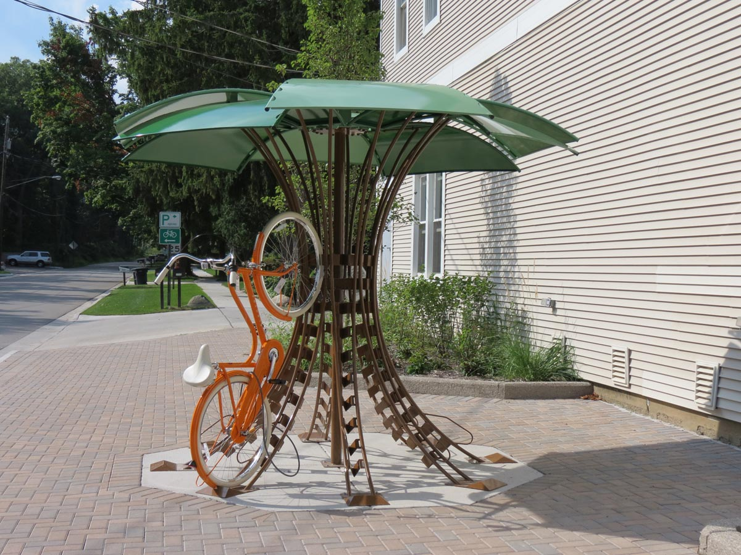
IT CAN BE DONE!
Bicycle infrastructure
Larger bike racks, communal & bike lockers, covered racks
The Evergreen State College, Michigan State University
Notes:
Evergreen commuter lockers are ventilated ->can store and dry rain gear.. PSU VIkeBike rental by semester.. Humboldt = Zimride

Slide 10
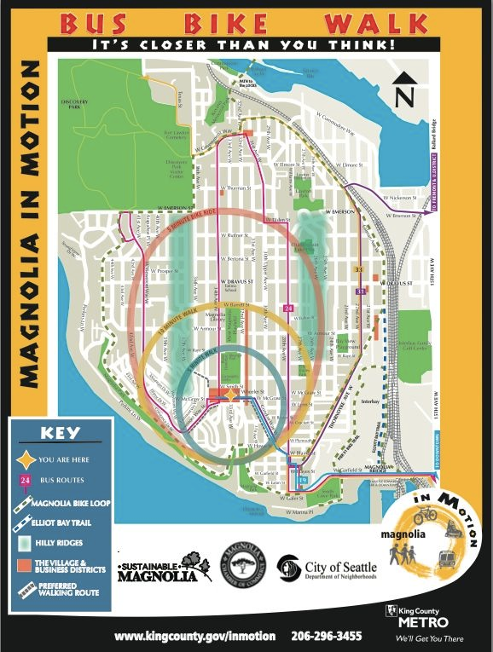
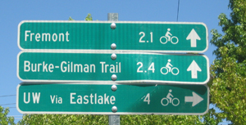
Magnolia wayfinding network

Slide 11
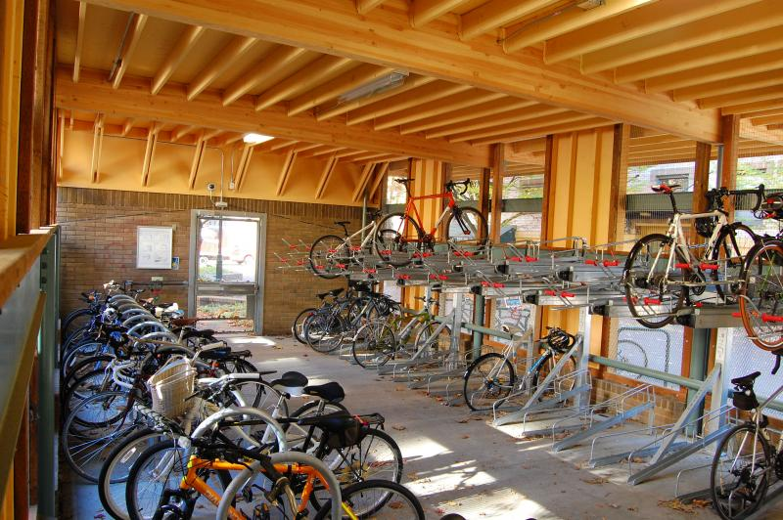
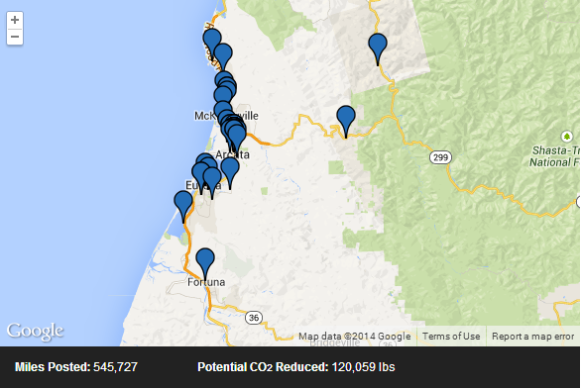
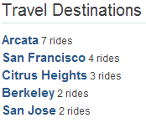
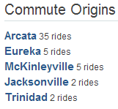
Bike & Rideshare Services
Notes:
Increasing carpooling, rideshare services, bike rental/share; For institutionally sponsored events, daily commutes, etc.; Portland State University and 126 other campuses

