Slide 1
Lights Out
Jenna & Mary

Slide 2
Our Purpose
We collected data on energy use, particularly lighting waste.
Notes:
Mary

Slide 3
Motivation
Western has received reports saying that many lights are left on throughout the night and this does not match up with the University’s promise of sustainability
Western’s Climate Action Plan and sustainability goals pledges to eliminate wasteful practices.
Bellingham has an eco-friendly culture
Notes:
Jenna

Slide 4
Investigative Process
From 7-9PM:
Locate accessible buildings and rooms on campus
Chronicle whether room is lit, dark, or occupied.
Count lights if applicable
We refined the process to seven academic buildings that had 15 or more accessible rooms, and then collected data from 10PM-12AM

Slide 5
Investigation Cont.
During the later time of 10PM-12AM, we noticed that we were collecting data while the custodial staff was working
We thought their activity could be invalidating the data we were trying to collect, so we pushed our surveillance times to after the night shift ended
Our final surveillance time was 11PM-3AM

Slide 6
Assumptions
Rooms that are occupied are not considered a waste of electricity
Custodial night staff are the last to leave the buildings, so if the lights are on when they leave they will stay on until campus re-opens at 5AM
In calculating how much money is wasted lighting empty rooms, generalizations are made about the wattage of light bulbs to simplify the computation
Automated lights are counted as “off”

Slide 7
Academic West
17 Rooms Total
189 long bulbs

Slide 8
Arntzen Hall
18 Rooms Total
211 long bulbs, 3 small bulbs

Slide 9
Communications
31 Rooms Total
146 long bulbs, 39 small bulbs

Slide 10
Parks Hall
21 Rooms Total
7 long bulbs

Slide 11
Fine Arts
12 Rooms Total
178 long bulbs

Slide 12
Bond Hall
27 Rooms Total
84 long bulbs, 34 short bulbs

Slide 13
Miller Hall
26 Rooms Total
44 long bulbs

Slide 14
Projected Savings
Total daily cost: $12.42
Total monthly cost: $344.35
Most expensive buildings: Fine Arts, Communications Facility, Academic West, and Arntzen Hall.

Slide 15
Waste by building
$84.57
$76.68
$50.23
$69.29
$43.65
$17.30
$2.82

Slide 16
What does our data say?
There’s still some room for improvement
More lights are on and more rooms are occupied earlier in the evening
From the outside, our campus looks terrible:

Slide 17
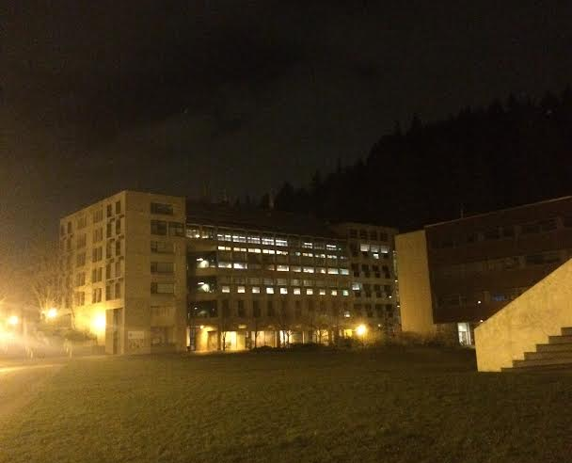

Slide 18
Because…
What the buildings look like from outside is very misleading compared to the data we have collected
All of the hallway lights are left on for safety reasons

Slide 19
We Suggest…
Using the as a stepping stone for finding solutions
Coordinating with custodians
Automated Lights
Adaptive Lights
Motion Sensors
Notes:
Cutting back on waste saves money and energy, and promotes sustainability

Slide 20
Don’t forget…
to turn out the lights!
Thank you.

