Slide 1
Sustainability Action Plan:
Grounds Chapter
Meredith Penny
Jendy Edgerton

Slide 2
Special Thanks to...
Gary Hodge
Randy Godfrey
Heidi Zeretzke
Jason Syre

Slide 3
Vision for Grounds:
To transform the Western community into a place where students and staff work together, striving to further sustainable practices on grounds, ensuring the health and vitality of future students.

Slide 4
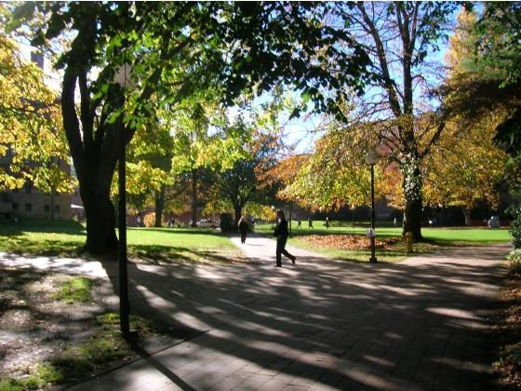
What does grounds encompass?
Plant debris recycling and composting
Campus outdoor aesthetics
Landscaping
Gardening

Slide 5
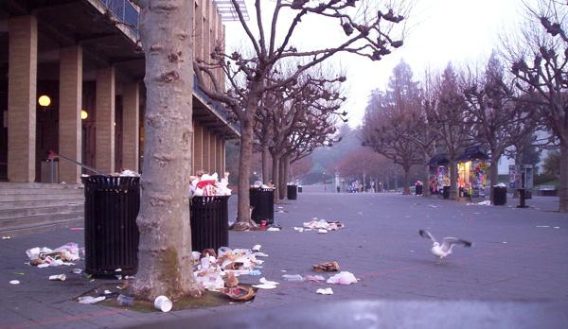
What issues are grounds staff facing?
Litter mainly from trash, compostables and cigarette butts
Lack of clear communication
Little to no student involvement/ awareness
Too few staff/ lack of funds to execute projects

Slide 6
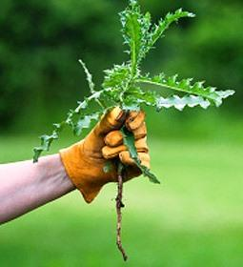
5 Main Goals:
Goal One: Record grounds activity
Goal Two: Increase communication
Goal Three: Reduce amount of litter/waste
Goal Four: Eliminate chemical based biocides
Goal Five: Reduce campus carbon emissions

Slide 7
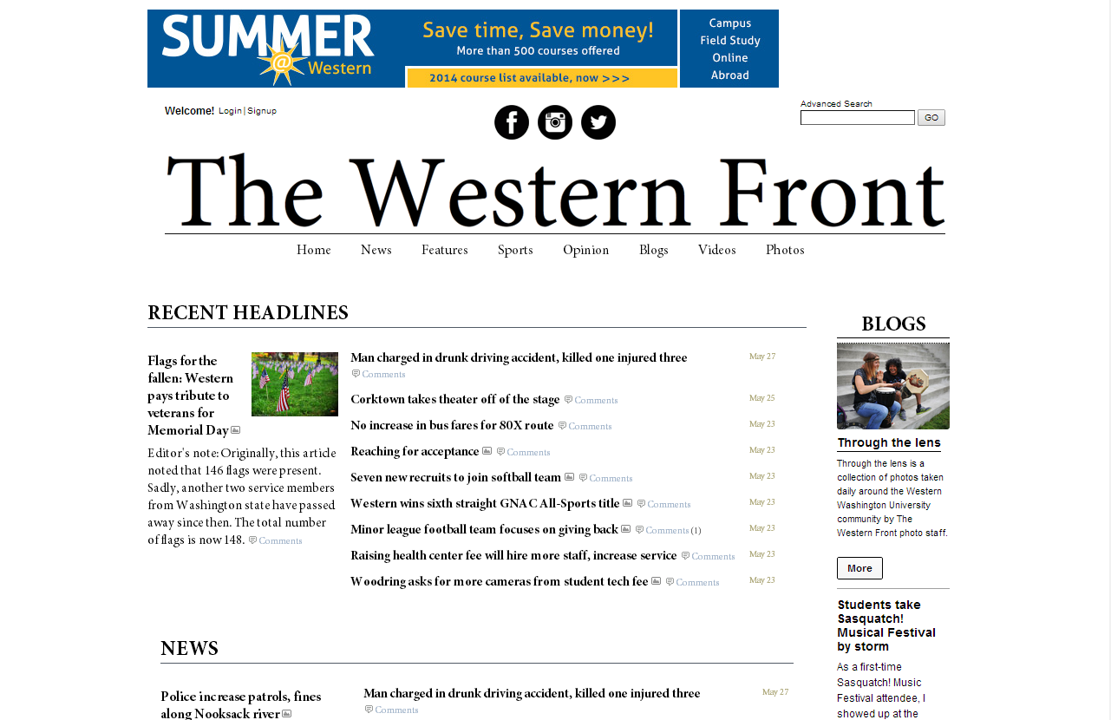
Major Action Steps
1. Student survey on weed tolerance
2. Publish litter article in Western Front
3. Merge grounds, student life and classroom activities
4. Ban the use of chemical based biocides

Slide 8
Key Performance Indicators
Fuel used: reduced by 20% by Spring 2018
Time gardeners spend picking up trash: reduce by 50% by Spring 2015
On-campus compost produced and used: double by 2025
Gallons of chemicals used: eliminate by Spring 2015
Response on weed tolerance survey: 70% positive response

Slide 9
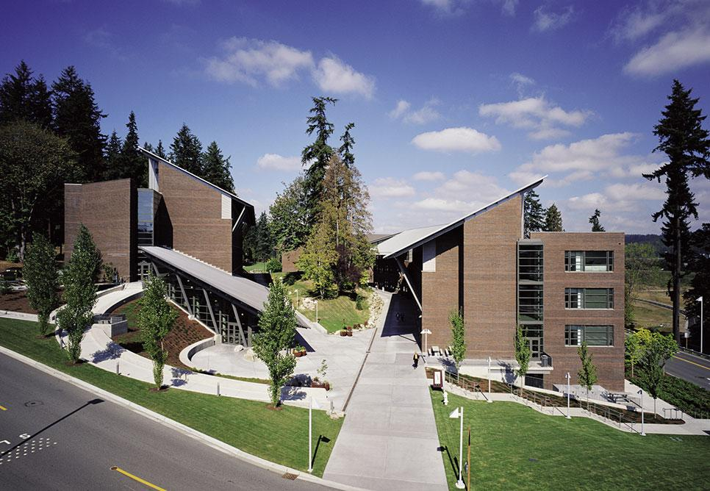
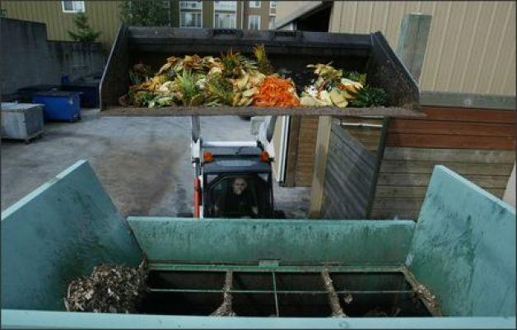
University Examples:
University of Washington Bothell
Pesticide free grounds
Seattle University
Pesticide free grounds
Indoor composting building

Slide 10
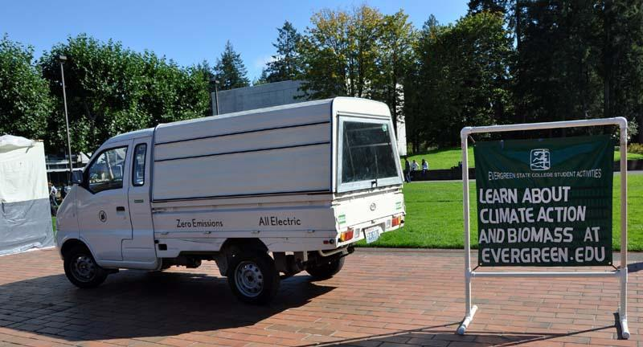
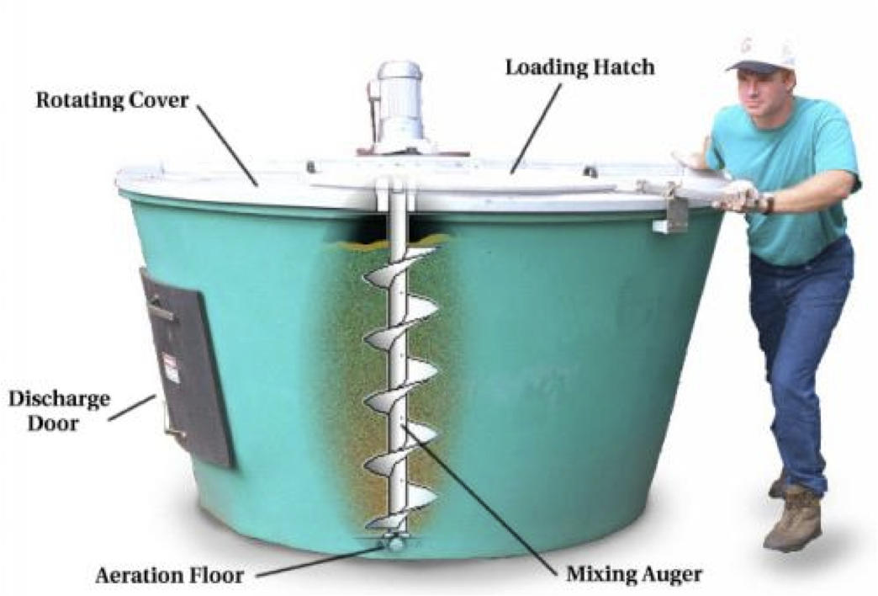
The Evergreen State College
Purchasing of electric vehicles
Mercyhurst University
Earth-Tub composting bins
bought with green-energy fee grant

