Slide 1
Green Energy Fee Survey
Marcus Nevitt, Shannon Beach, and Maryellen Sheppard
Notes:
Marcus

Slide 2
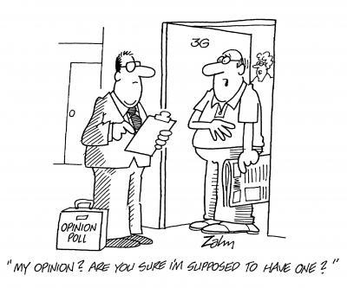
Presentation Outline
Background on Westerns’ Green Energy Fee
Project Objectives
Distribution of Survey
Data and Results
Summary of Results
Recommendations
Notes:
Shannon

Slide 3
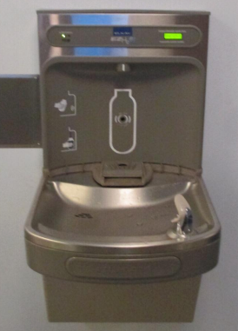
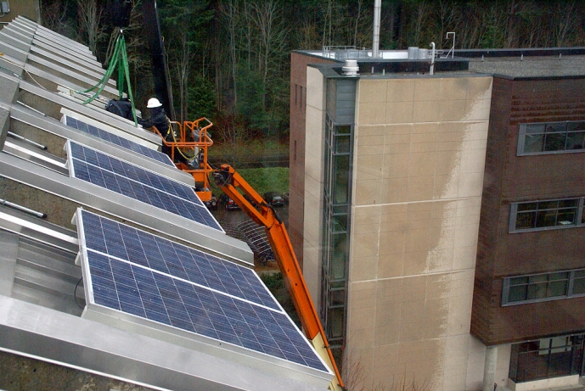
GEF Background
Notes:
M.E

Slide 4
Survey Objectives
Assess student awareness of the Green Energy Fee.
Determine percentage of students likely to vote.
Quantify students’ willingness to pay for the Green Energy Fee.
Notes:
Marcus – shorten sentences. Match likeliness to vote with survey question.

Slide 5
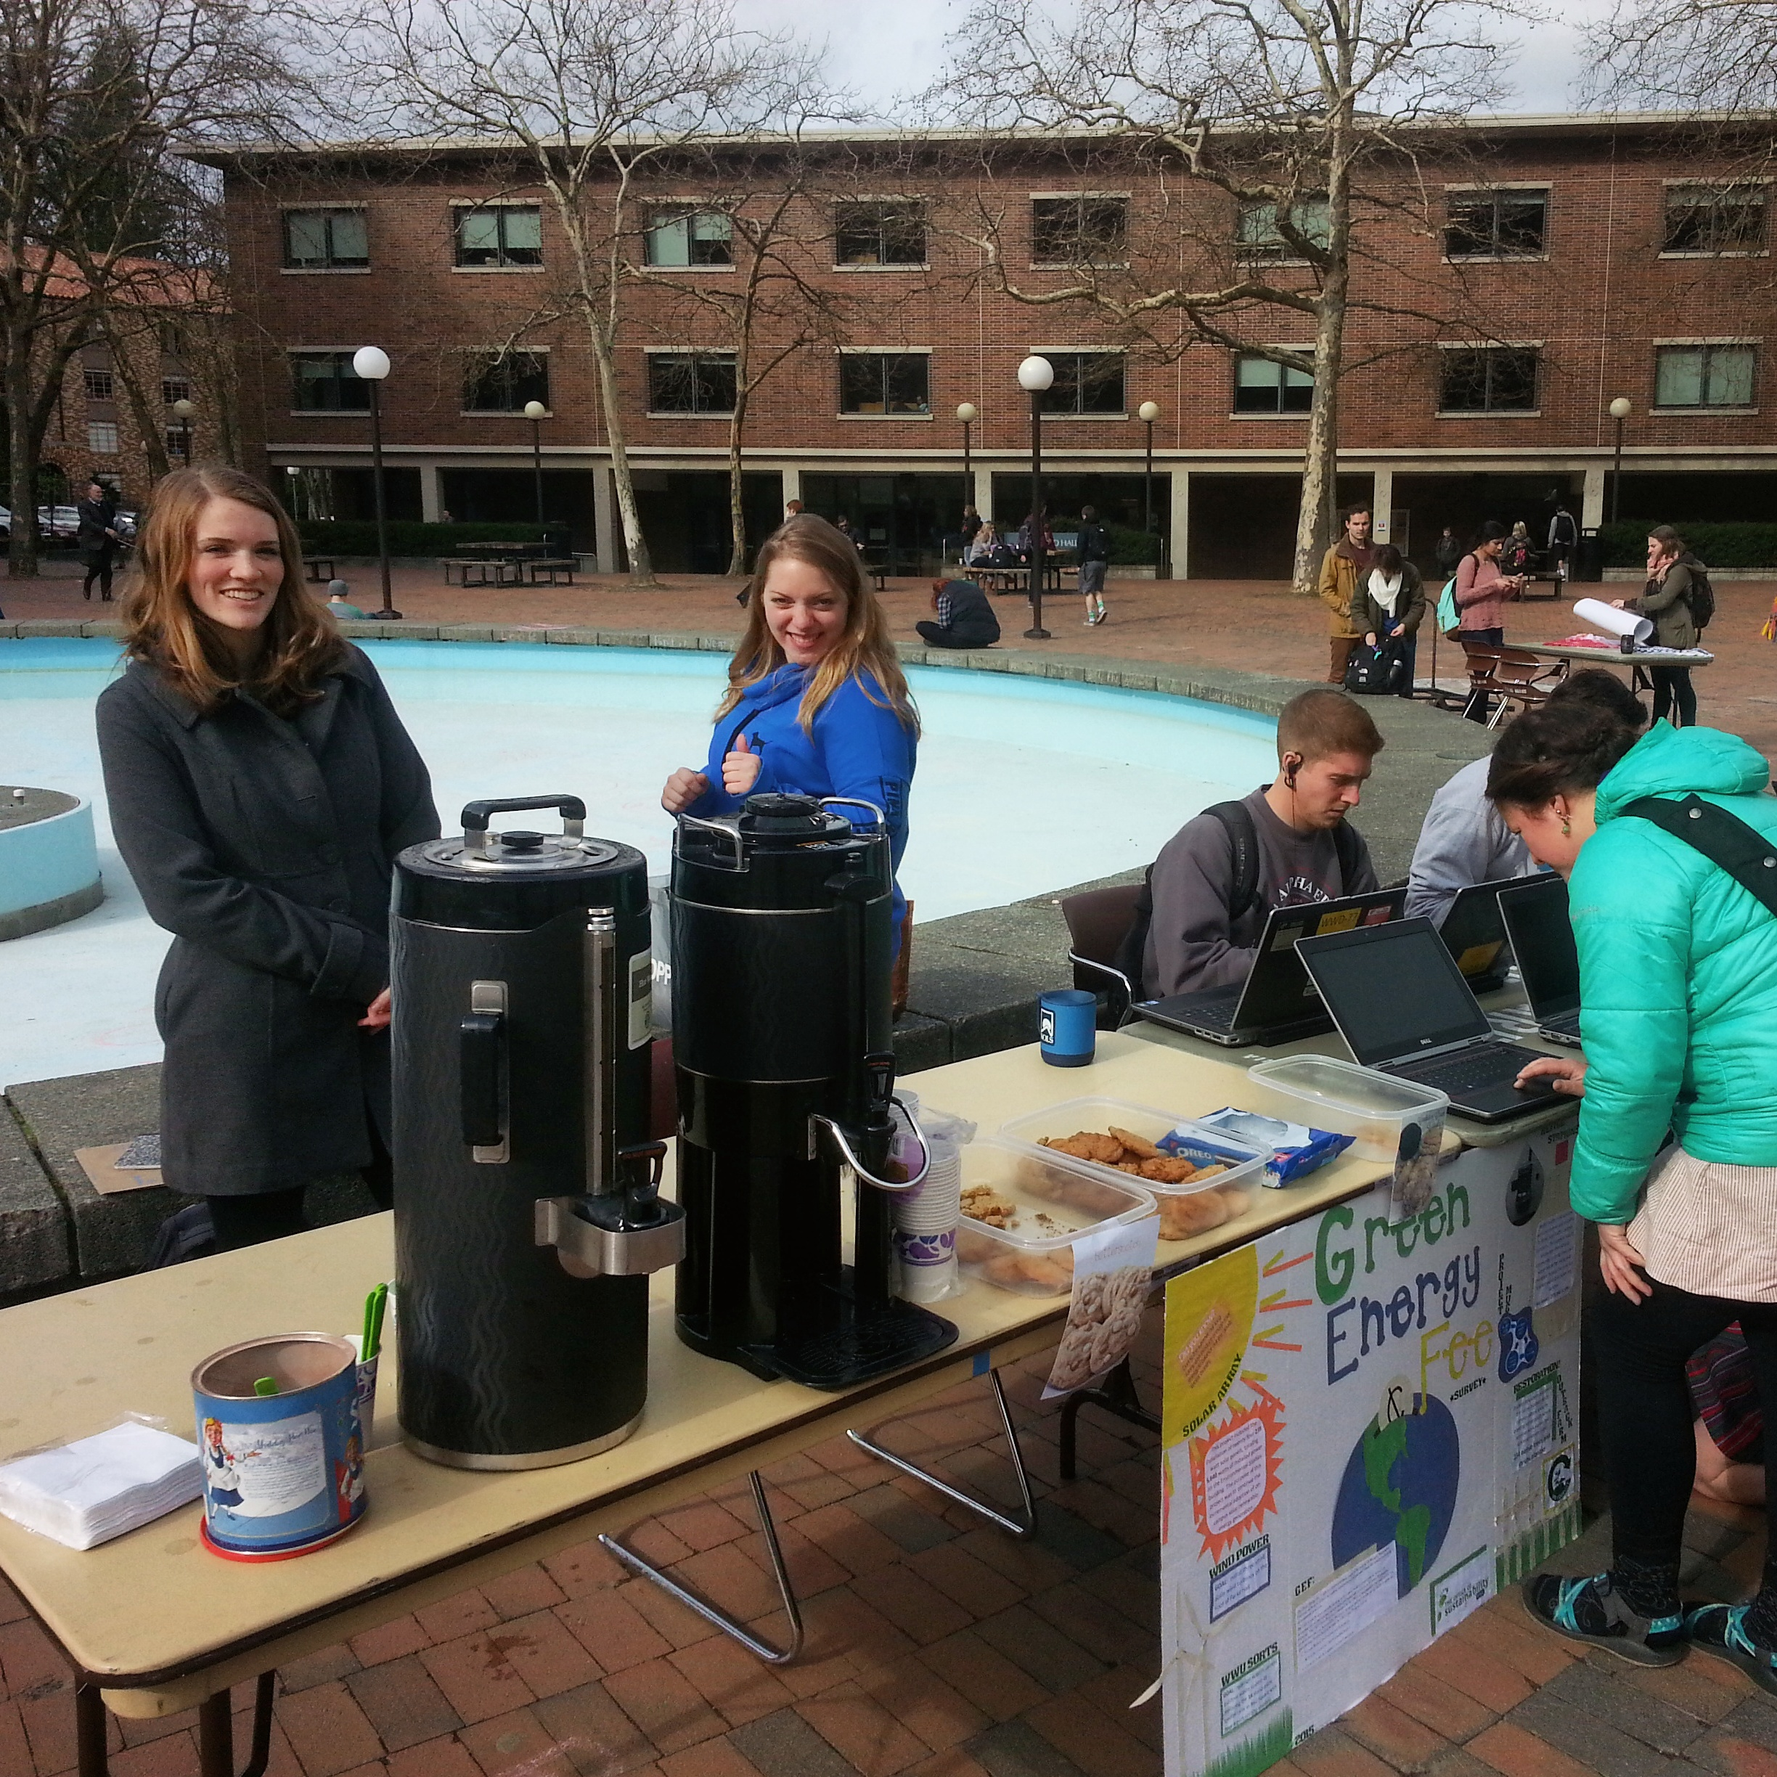
Survey Distribution
Distribution methods
Stakeholder meetings
Informational visual
Student input
Total Responses: 335
Notes:
Maryellen/shannon – Increase photo brightness. “pull people in” vs “people walk up”.

Slide 6
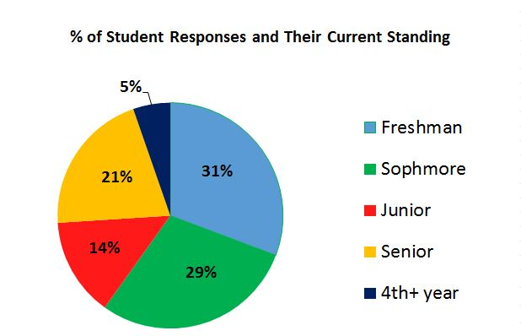
Data and Results
About 5% of survey participants are seniors.
Approximately 60% of students are in their 1st or 2nd year at Western.
Total Participants: 335 Students
Notes:
Marcus freshman are more likely to vote/ pay more often

Slide 7
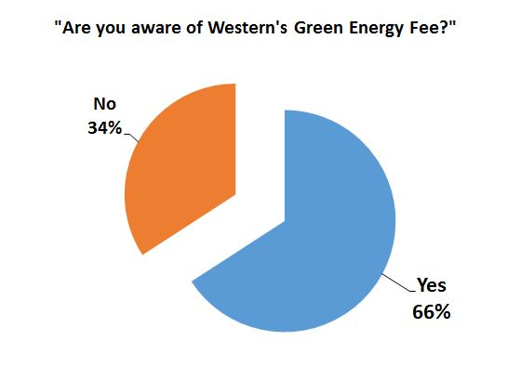
Data and Results
Notes:
Marcus

Slide 8
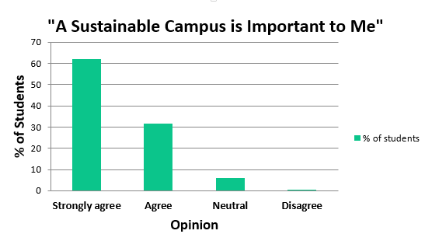
Data and Results
Notes:
Maryellen put statement in quotations. Change color. 93% said strongly agree/agree

Slide 9
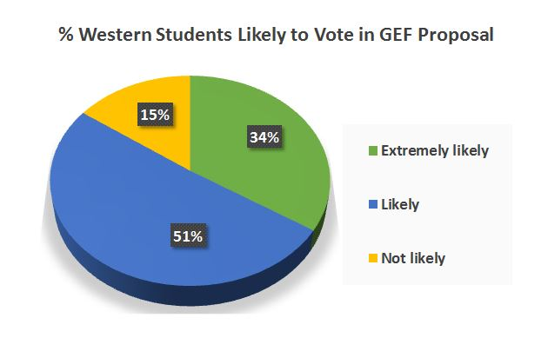
Data and Results
“How likely are you to vote in the upcoming Spring election?”
Notes:
Shannon. Match question to statement

Slide 10
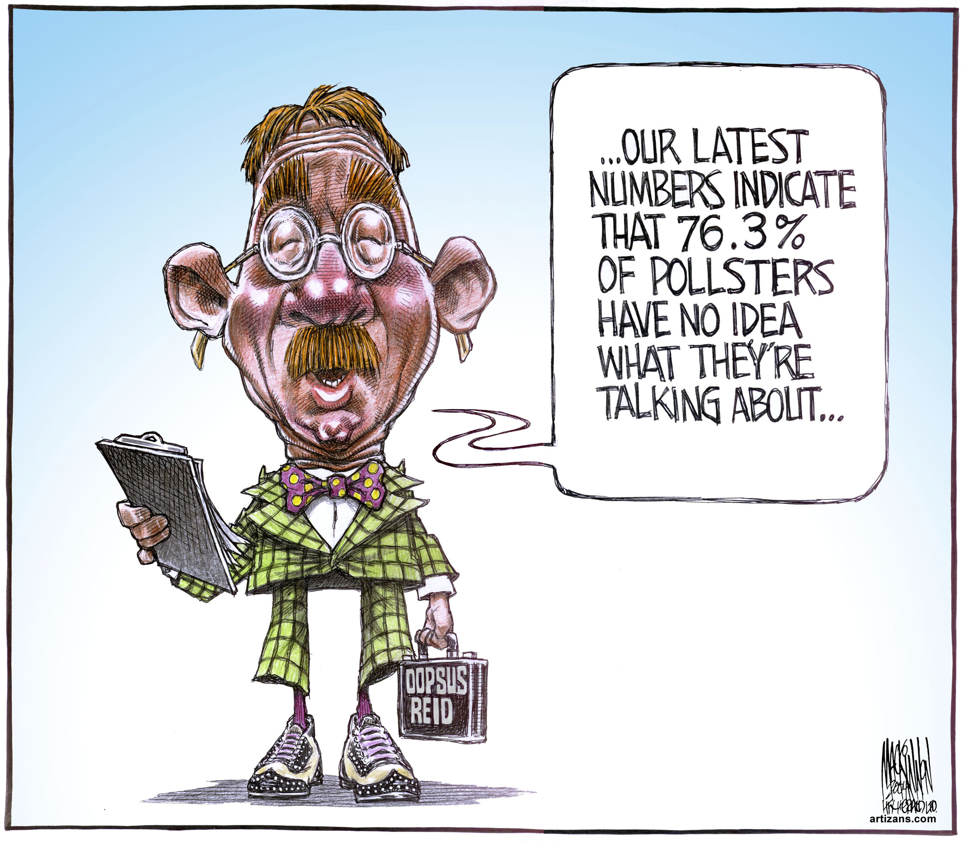
Why aren’t people voting?
“Unaware”
“Pessimist”
“Away from campus”
“Graduation”
“Laziness”
Notes:
shannon

Slide 11
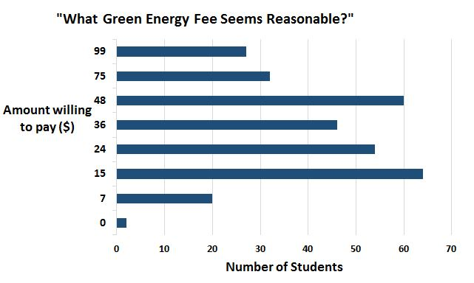
Data and Results
Median: $34
The majority of Western students thought $15-48 was a reasonable price for the Green Energy Fee.
Notes:
Maryellen/marcus. Insert question. Address difficulty of asking WTP and how we came up with our numbers. Address randomness of scale. Median price was 34. Nate told us the goal was $20

Slide 12
Summary of Results
+/- 5% accuracy
$15-48 price range for the GEF
6% of students said $7 is reasonable
93% of students said having a sustainable campus is important
85% of students are likely to vote
Notes:
Marcus- x% thinks <7$ ? objectiveness

Slide 13
Recommendations
Student outreach needed
Student uncertainties
Student awareness on how and when to vote
Notes:
Maryellen. Say these points..dont need to be on slides

Slide 14
Thank You!
Questions?
Notes:
Marcus/Maryellen

