Slide 1
2015 Sustainable Literacy Survey
The Office of Sustainability
Campus Sustainability Planning Studio
Emily Koryto, Nicole Espe, & Kaeli Wells

Slide 2
Goals & Commitments
Climate Neutrality by 2050
Zero Waste Western
30% Real Food by the end of 2020

Slide 3
What does sustainability literacy mean to you? Which programs exist to further sustainability on campus?

Slide 4
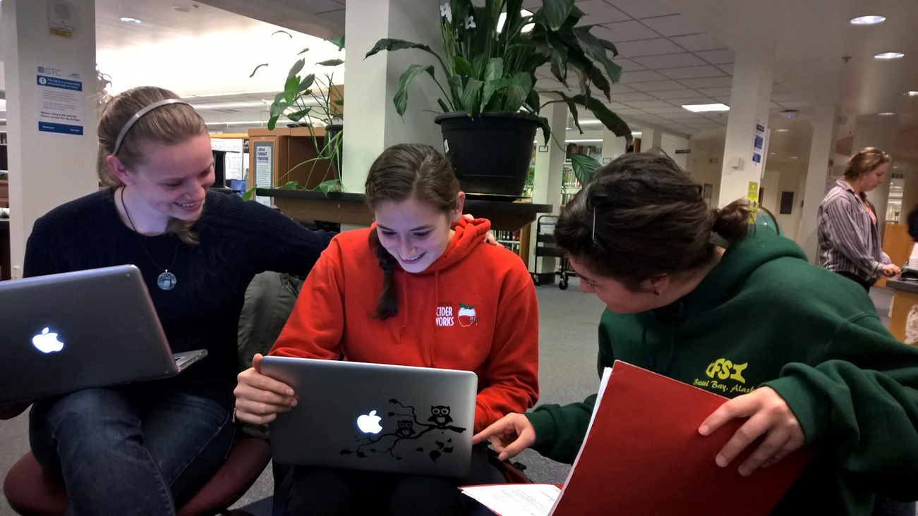
Objectives
Assess the student knowledge of sustainability on Western's campus
Track sustainability awareness trends over time
Prioritize efforts to serve Western's community
Collect data for the first time

Slide 5
The Interviewing Process
Faculty, administrators, & student leaders
Over 20 interviews
Environmental, economic, and social impacts

Slide 6
Interview Questions
“In which ways can we make sustainable practices more intuitive for students/ faculty?”
“How has the concept of sustainability changed in your lifetime?”
“What has made these kinds of surveys successful in the past? Do you have any suggestions for creating a better survey in the future?”

Slide 7
The Survey
Values
Opinions on Western
Behavior/ Action
Knowledge

Slide 8
Notes:
These next few slides will show some of the questions from the survey. There are a few different formats we used such as this grid which ranges from Strongly Agree to Strongly Disagree. This question regards one of the topics we wanted to address in our survey, environmental and the other two are economic and social.

Slide 9
Notes:
This question “_______” is in checkbox format and addresses economy.

Slide 10
Notes:
This question, in Multiple choice format, received mostly positive feedback and was important because it allows us to see if sustainability is marketable.

Slide 11
Feedback from Faculty
“Social equity is not the same as social justice. I'd suggest you include items that address both.”
Notes:
After we created the first draft of our survey we sent it out to faculty for feedback. We received a lot of mixed reviews, negative or positive, we took each comment into consideration and made the necessary changes on the survey. For example, this feedback quote told us we needed to put more questions about social justice on the survey and to make the distinction between justice and equity clearer.

Slide 12
Feedback from Faculty
“The first two items are worded in a way that it would generally be considered socially unacceptable to answer in the negative.”
Notes:
This comment from a faculty member allowed us to reword the questions so we could get more of an honest response. We also added more social justice questions from this feedback.

Slide 13
Feedback from Faculty
“In what ways would you like to change or improve Western‘s sustainability reputation/brand?”
Notes:
This type of feedback was the most common and asked us to go over wording and try to find the right word(s) that conveyed our purpose for the question. This was perhaps one of the most difficult parts of editing because of conflicting reviews

Slide 14
Feedback from Faculty
“Over all I think this will be a great source of information for our programs and I am excited to see the results.”
Notes:
Feedback like this was great to read and confirmed we were on the right track for some of the questions.

Slide 15
Notes:
Pictured here is the group in one of our editing modes which at times was frustrating and confusing.

Slide 16
Upcoming Goals
Office of Sustainability will distribute survey to students in Fall 2015
Monitor how students’ sustainability literacy changes each year
Use data to influence how Western approaches sustainable literacy
Notes:
Since we only have a limited time for this project we will not be the ones distributing the survey but the O of S will send it out to the student body this upcoming Fall.
Our goals for this project include, being able to monitor a freshmen’s literacy until they are seniors and graduate. We want to learn what has changed for them and how can Western utilize that data to approach sustainable literacy.

Slide 17
Thank you for your support! If you have any questions please contact Seth Vidana at the Office of Sustainability.
Notes:
We would like to thank everyone who helped us with our project and for listening to our presentation. Thank you!

