Slide 1
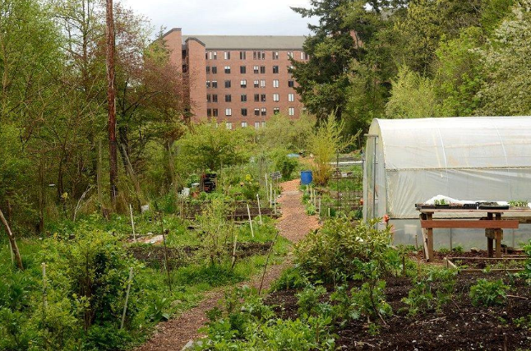
Dining Services Action Plan
Importance
Issues, challenges, opportunities
The Outback Farm at WWU
Notes:
*
*

Slide 2
Goals for Dining
Increase energy efficiency
Reduce waste
Increase Real Food Challenge score – stretch goal of 40% by 2020
Produce foods through Western run farm(s)
Preserve culture of sustainability in dining services
Notes:
*
*

Slide 3
Vision
Western Washington University strives to be a leader in sustainable food service practices, with goals and policies that keep ambitions high and progress continual in all service areas
Notes:
*
*

Slide 4
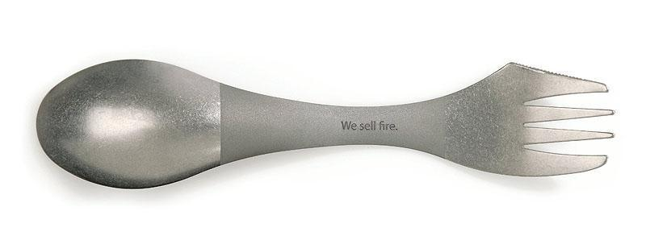
The Action Steps
Possible with current resources
Research methods to track current energy and water usage
Research costs and implement reusable utensil program The University of Vermont has a spork program which has reduced compostable utensil waste and purchasing
Research possible herb or produce production at the Outback Farm to be used by University Dining Services
Notes:
*
*

Slide 5
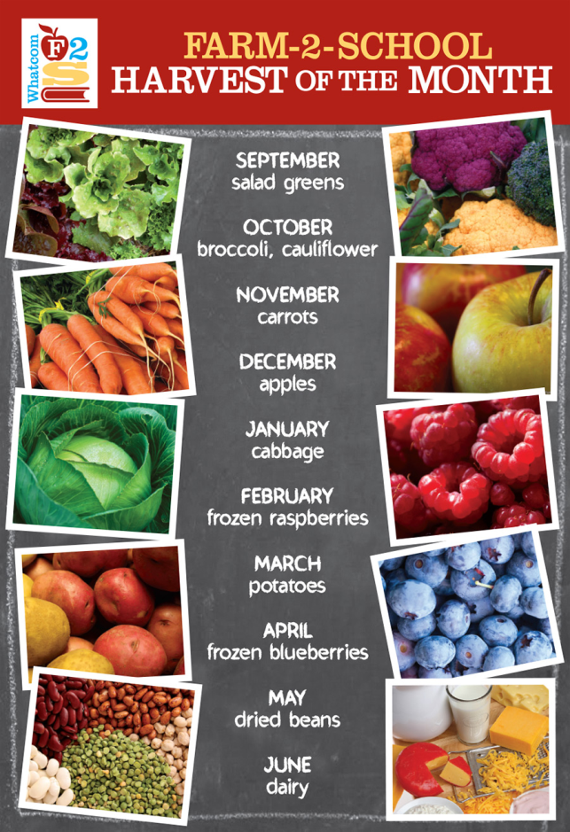
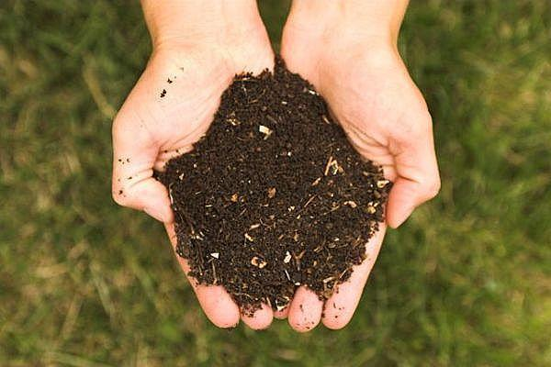
The Action Steps
Possible with additional resources
On-site composting
Creation of more meals based on local seasonal foods The Bellingham School District serves “Harvest of the Month” meals
Notes:
*
*

Slide 6
The Action Steps
Possible through policy change
Creation of MOU between University Residences and the food service provider to uphold sustainability standards
Notes:
*
*

Slide 7
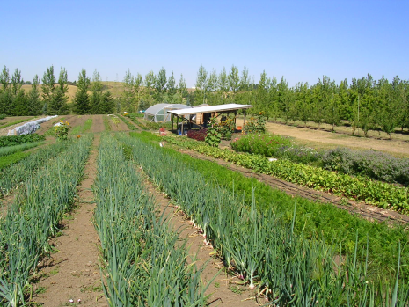
The Action Steps
Possible with institutional investment
Replacement of all aged equipment with new energy efficient equipment Boston College replaced two aged dishwashers with new Energy Star models and cut water consumption by 50%
Purchase of county farm land to grow food for University Dining Services
WSU's four-acre organic farm
Notes:
*
*

Slide 8
Key Performance Indicators
Energy use: Reduce by 35% by 2020
Water use: Reduce by 25% by 2020
Waste generated: Reduce
Real Food Challenge score: 40% by 2020
Notes:
*

