Slide 1
Waste & Recycling Action Plan
Lauren Anderson, Rosie Matsumoto, Mackenzie Will, & Amel Abdelli
CSPS/Office of Sustainability
Intro // Stakeholders // Survey // Rankings // Action Plan // KPI’s // Conclusion

Slide 2
Stakeholders
Custodian | Mike Smith
Mgr Building Services | Don Bakkensen
Ex. Chef | Patrick Durgan
ResRAP Coordinator(dorms) | Maddie Gavigan
Assoc Dir Univ Res for Res Life | John Purdie
Maintenance Specialist | Randy Godfrey
Dir Environmental Health Safety | Sue Sullivan
Safety Officer | Dave Keeney
Maintenance Specialist | Gary Hodge
Asst Dir FDCA | Ed Simpson
Coordinator | Charlie Ayers
Dir Campus Recreation | Marie Sather
Ass. Dir. Campus Rec srvs | Adam Leonard
Asst Dir Facility Mng | Pete Lockheart
Asst Dir VU Facilities | Greg McBride
VP of AS | Zach Dogovich
Program Support Supervisor | Rich Neyer
VU Recycling Education Coordinator | Camilla Paine
Mgr of Facilities Operations | Dave Rubel
OS Program Coordinator | Wendy Crandall
SSC Recycling Manager | Rodd Pemble
Divisions:
Enrollment & Student Services (ESS)
Business & Financial Affairs (BFA)
Office of Sustainability (OS)
Associated Students (AS)
Intro // Stakeholders // Survey // Rankings // Action Plan // KPI’s // Conclusion
Notes:
AMEL
list the times of the meetings, names, and what they do
talk about the process of our project: research, interviews, draft with goals, objectives & strategies, student survey in Red Square, created final document with action plan
refer to area stakeholders table in condensed Action Plan

Slide 3
Process
Intro // Stakeholders // Survey // Rankings // Action Plan // KPI’s // Conclusion

Slide 4
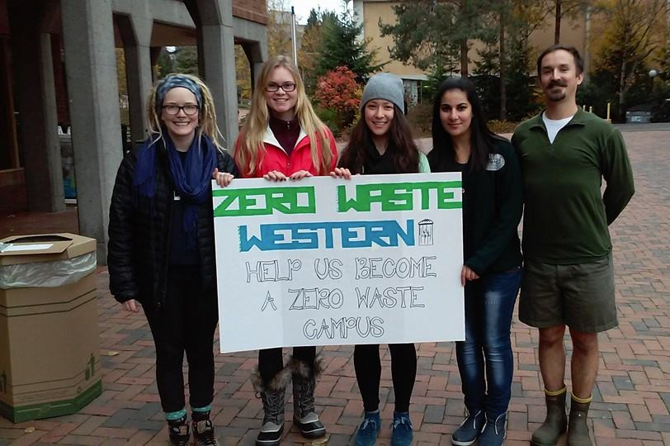
Red Square Survey
229 responses
93% students
40% seniors
76% live off campus
Wide range of majors
Intro // Stakeholders // Survey // Rankings // Action Plan // KPI’s // Conclusion
Notes:
ROSIE

Slide 5
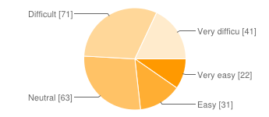
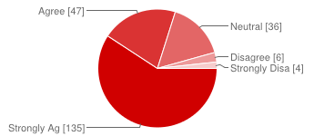
How easy is it for you to find a place to recycle organic waste in outdoor areas on campus?
Very easy | 22 | 10%
Easy | 31 | 14%
Neutral | 63 | 28%
Difficult | 71 | 31%
Very difficult | 41 | 18%
"It is important to me to have campaigns to reduce the amount of cigarette butt litter on campus."
Strongly Agree | 135 | 59%
Agree | 47 | 21%
Neutral | 36 | 16%
Disagree | 6 | 3%
Strongly Disagree | 4 | 2%
Intro // Stakeholders // Survey // Rankings // Action Plan // KPI’s // Conclusion

Slide 6
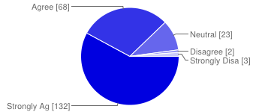
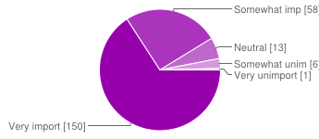
"I would like to see better organic waste sorting options on campus."
Strongly Agree | 132 | 58%
Agree | 68 | 30%
Neutral | 23 | 10%
Disagree | 2 | 1%
Strongly Disagree | 3 | 1%
How important is to you to buy items on campus with minimal packaging or recycleable packaging?
Very important | 150 | 66%
Somewhat important | 58 | 25%
Neutral | 13 | 6%
Somewhat unimportant | 6 | 3%
Very unimportant | 1 | 0%
Intro // Stakeholders // Survey // Rankings // Action Plan // KPI’s // Conclusion

Slide 7
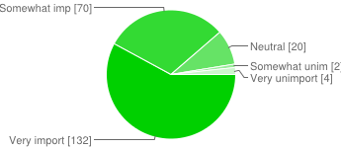
How important is to you to provide students, staff, and faculty with more opportunities to take action in waste reduction and environmental stewardship?
Very important | 132 | 58%
Somewhat important | 70 | 31%
Neutral | 20 | 9%
Somewhat unimportant | 2 | 1%
Very unimportant | 4 | 2%
Intro // Stakeholders // Survey // Rankings // Action Plan // KPI’s // Conclusion

Slide 8
Stakeholder’s Top Priorities
Ensure waste is properly sorted into correct bins:
Waste education for incoming students
Uniform sorting depots indoors and outdoors
Uniform signage
Increase composting
More opportunities for campus community
Campaigns
Reduce amount of stand alone landfill bins & replace with sorting depots
Increase use of local and sustainable packaging
Intro // Stakeholders // Survey // Rankings // Action Plan // KPI’s // Conclusion
Notes:
LAUREN

Slide 9
Action Plan
Available Resources (no funding needed)
Additional Resources ($0-100,000)
Institutional Investment ($100,000- 1 million)
Intro // Stakeholders // Survey // Rankings // Action Plan // KPI’s // Conclusion
Notes:
LAUREN
Stakeholder ratings of importance & student survey results
Summarize action plans (objectives, strategies- only when talking and not on pwrpt)

Slide 10
Available Resources
Recycling education in Freshman orientation to reach incoming students
Enrollment & Student Services
September 2015
2. Quarterly “Waste Weeks” to educate buyers on how to recycle their containers, have clearly labeled containers for sorting, and volunteer waste sorters to educate users
VP Business & Financial Affairs
April 2015
Campaign on consumer choices & its effects on campus’ waste stream
AS/Office of Sustainability
September 2015
Intro // Stakeholders // Survey // Rankings // Action Plan // KPI’s // Conclusion

Slide 11
Additional Resources ($0-100,000)
1. Improved uniform signage for all recycling bins, sorting stations, and landfill containers
VP Business & Financial Affairs
January 2016
2. Compost paper towels in all campus bathrooms
VP Business & Financial Affairs
January 2016
3. All food packaging should be recyclable or compostable
Enrollment & Student Services
January 2016
Intro // Stakeholders // Survey // Rankings // Action Plan // KPI’s // Conclusion

Slide 12
Additional Resources ($0-100,000)
Implement cigarette butt litter campaign to educate on the amount of litter produced & the need for improved smoking stations
AS/Office of Sustainability
September 2015
Intro // Stakeholders // Survey // Rankings // Action Plan // KPI’s // Conclusion

Slide 13
Institutional Investment ($100k-1 mil)
Install uniform 4 part sorting depots indoors and outdoors across campus
VP Business & Financial Affairs
September 2016
Intro // Stakeholders // Survey // Rankings // Action Plan // KPI’s // Conclusion

Slide 14
Key Performance Indicators
Intro // Stakeholders // Survey // Rankings // Action Plan // KPI’s // Conclusion
Notes:
Talk about what KPI is & why we added them

Slide 15
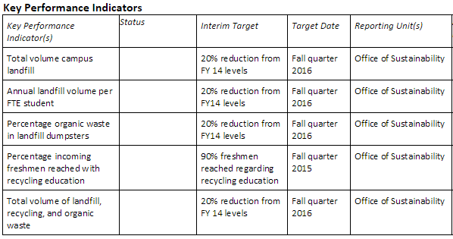
Key Performance Indicators
Intro // Stakeholders // Survey // Rankings // Action Plan // KPI’s // Conclusion
Notes:
MACKENZIE
list them off, they are self-explanatory
Total volume campus landfill
Annual landfill volume per Full Time Equivalent student
Percentage of organic waste in landfill
Total volume of landfill, recycling, & organic waste
20% reduction from FY 14 levels
Target: Fall quarter 2016
Percentage of incoming freshman reached with recycling education
90% freshman regarding recycling education
Target: Fall quarter 2015
→ Reported by the Office of Sustainability

Slide 16
Thank you for your time,
we will now open up discussion!
Intro // Stakeholders // Survey // Rankings // Action Plan // KPI’s // Conclusion

Slide 17
